Slide 1

LIU Sicen 刘思岑
—— Department of Computer Science and Engineering, Southern University of Science and Technology
Like electronic arts (painting & music), computer science and physics
QQ: 1257728103
Wechat: L_Azrael_
Email: 11910338@mail.sustech.edu.cn
GitHub: Lance-Azrael

Slide 2




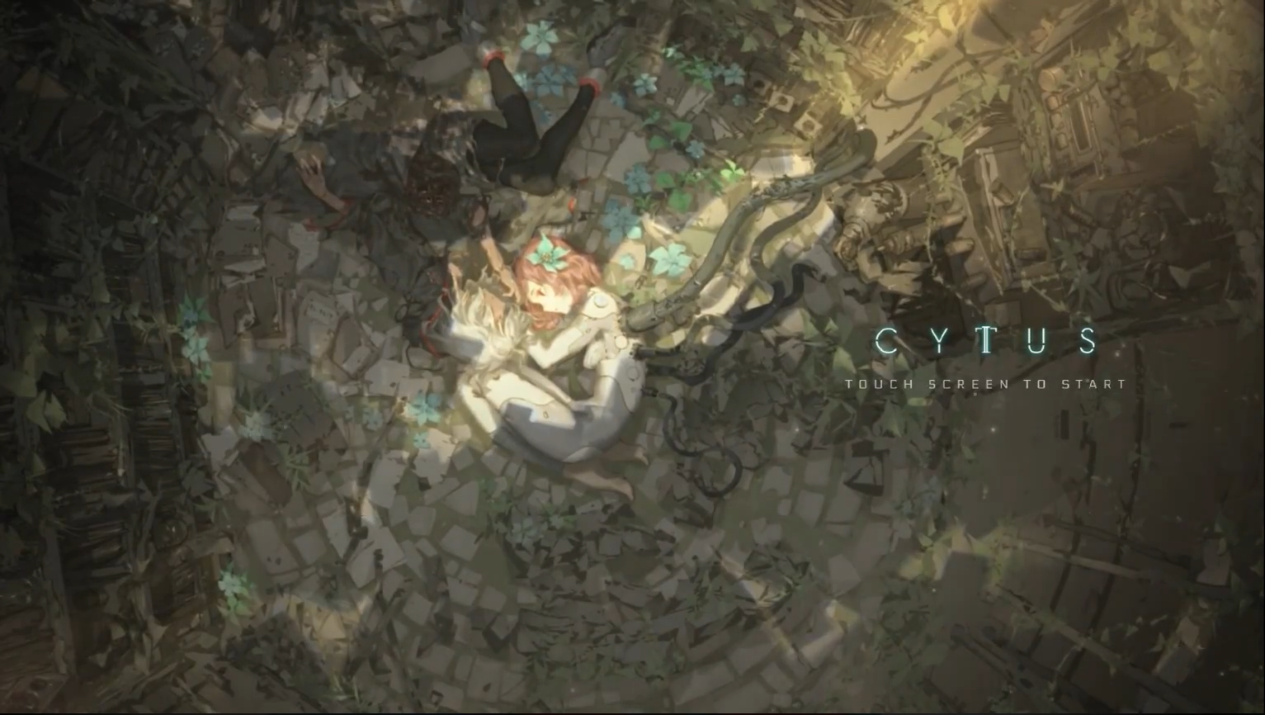


Focusing on Videogames
Nintendo ruled the world！
Puzzle adventure
Music Games
Main platform:
Nintendo DS -> Nintendo Switch & PC

Slide 3








Focusing on Videogames
Focus on way of expression: the mood conveyed by graphics and music, and the sense in the plot and interaction
Other Console Games:

Slide 4
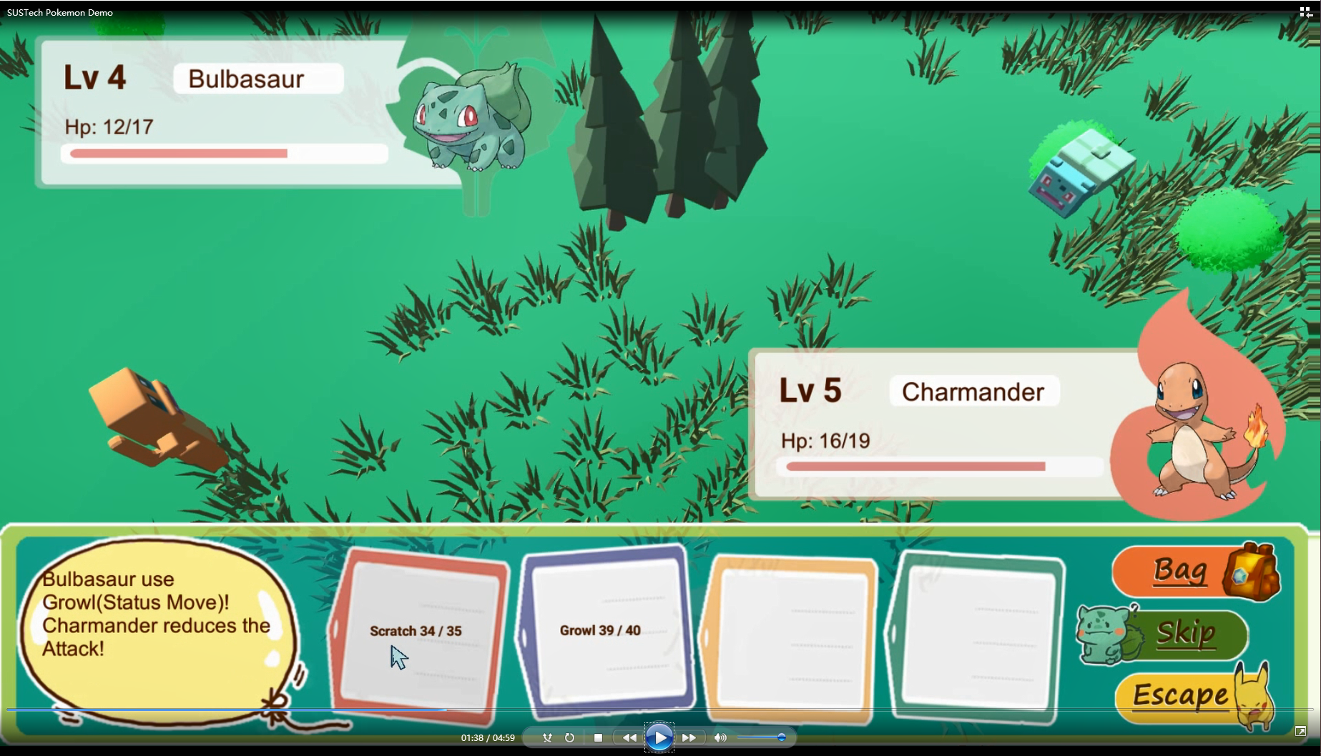

Building of Videogames
Course project in Object-Oriented Analysis And Design in 2019 Fall
By four group members
Combat system, growth system, interactive 3D interface
Made by Unity3D

Slide 5
strength:
Java, Python, C#, a little game developing experience
Photoshop, Electronic drawing, Video Editing
Hope we can cooperate happily!

